Slide 1
Data Structure and Algorithm

Slide 2
Definition, Structure and Properties of algorithms
Definition : An algorithm may be defined as a finite sequence of instructions each of which has a clear meaning and can be performed with finite amount of effort in a finite length of time.
Structure and properties An algorithm has the following structures: (i) Input step (ii) Assignment step (iii) Decision step
(v) Output step
(iv) Repetitive step

Slide 3
An algorithm is endowed with the following properties:
Finiteness an algorithm must terminate after a finite number of steps. Definiteness the steps of the algorithm must be precisely defined or unambiguously specified. Generality an algorithm must be generic enough to solve all problems in a particular class. Effectiveness the operations of the algorithm must be basic enough to be put down on pencil and paper. They should not be too complex to warrant writing another algorithm for the operation! Input—Output the algorithm must have certain initial and precise inputs, and outputs that may be generated both at its intermediate and final steps.

Slide 4
Development of an Algorithm
The steps involved in the development of an algorithm are as follows: (i) Problem Statement (ii) Model Formulation (iii) Algorithm design (iv) Algorithm correctness
(v) lmplementation
(vi) Algorithm analysis
(vii) Program testing
(viii) Documentation

Slide 5
Once a clear statement of the problem is done, the model for the solution of the problem is to be formulated.
The next step is to design the algorithm based on the solution model that is formulated. It is here that one sees the role of data structures. The right choice of the data structure needs to be made at the design stage itself since data structures influence the efficiency of the algorithm.
Once the correctness of the algorithm is checked and the algorithm implemented, the most important step of measuring the performance of the algorithm is done. This is what is termed as algorithm analysis. It can be seen how the use of appropriate data structures results in a better performance of the algorithm.
Finally the program is tested and the development ends with proper documentation.

Slide 6
Data Structures and Algorithms
The design of an efficient algorithm for the solution of the problem calls for the inclusion of appropriate data structures.
A clear, unambiguous set of instructions following the properties of the algorithm alone does not contribute to the efficiency of the solution.
It is essential that the data on which the problems need to work on are appropriately structured to suit the needs of the problem, thereby contributing to the efficiency of the solution.

Slide 7
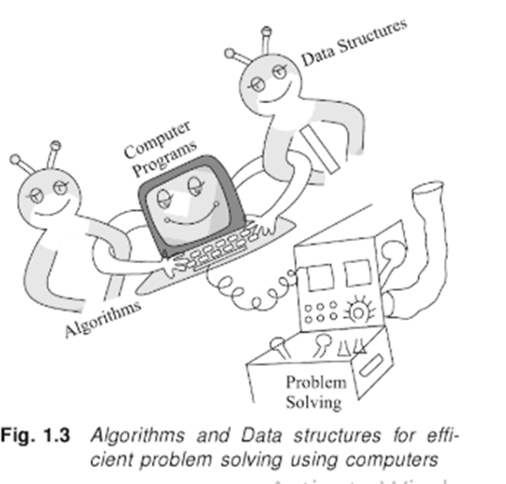
Example
This is a classic example to illustrate the significant role played by data structures in the efficiency of algorithms. The problem was retrieval of a telephone number. The algorithm was a simple search for the name in the directory and thereby retrieve the corresponding telephone number. In the first case since the data was appropriately structured (sorted according to alphabetical order), the search algorithm undertaken turned out to be efficient. On the other hand, in the second case, when the data was unstructured, the search algorithm turned out to be crude and hence inefficient. For the design of efficient programs and for the solution of problems, it is essential that algorithm design goes hand in hand with appropriate data structures. (Refer Fig. 1.3.)

Slide 8
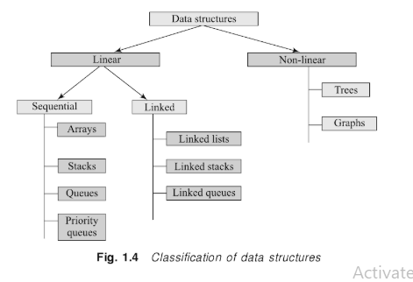
Classification
Figure 1.4 illustrates the classification of data structures.
The data structures are broadly classified as linear data structures and non-linear data structures.
Linear data structures are uni - dimensional in structure and represent linear lists.
These are further classified as sequential and linked representations.
On the other hand, non-linear data structures are two-dimensional representations of data lists. The individual data structures listed under each class have been shown in Fig. 1.4.

Slide 9
Analysis of algorithms
Efficiency of algorithms
Apriori analysis
Asymptotic notations
Time complexity of an algorithm using O notation
Polynomial vs Exponential algorithms
Average, Best and Worst case complexities
Analyzing recursive programs

Slide 10
Efficiency of algorithms
The performance of algorithms can be measured on the scales of time and space , the performance measure is termed time complexity and space complexity respectively.
The empirical or posteriori testing approach calls for implementing the complete algorithms and executing them on a computer for various instances of the problem.
The theoretical or apriori approach calls for mathematically determining the resources such as time and space needed by the algorithm, as a function of a parameter related to the instances of the problem considered

Slide 11
Apriori analysis
Apriori estimation is interested in the following for the computation of efficiency:
(i) the number of times the statement is executed in the program, known as the frequency count of the statement, and
(ii) the time taken for a single execution of the statement

Slide 12
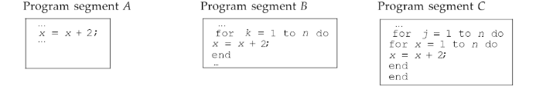
Example
Let us estimate the frequency count of the statement x = x + 2 occurring in the following three program segments (A, B, C):
The computation of the total frequency count of the program segments A, B, and C are shown in Tables 2.1, 2.2 and 2.3. It is well known that the opening statement of a for loop such as for I = low_index to up index executes ((up_index -low_index +1) +1 times and the statements within the loop are executed (up index—low index) +1 times.

Slide 13
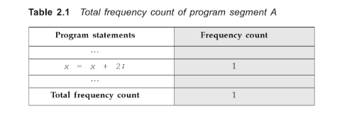
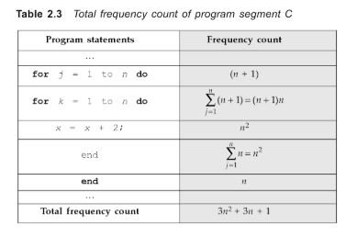
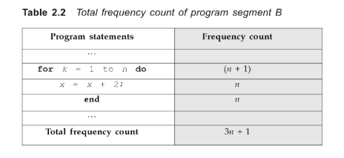

Slide 14
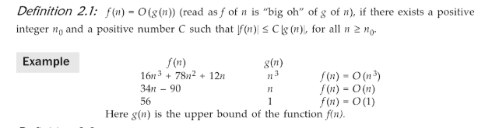
Asymptotic notations
Apriori analysis employs the following notations to express the time complexity of algorithms. These are termed asymptotic notations since they are meaningful approximations of functions that represent the time or space complexity of a program.

Slide 15
Time complexity of an algorithm using O notation
Algorithms reporting O(1) time complexity indicate constant running time.
The time complexities of O(n), O(n²) and O(n³) are called linear, quadratic and cubic time complexities respectively. O(log(n)) time complexity is referred to as logarithmic. In general, time complexities of the type Q(k) are called polynomial time complexities.
Time complexities such as O(2^{n}), O(3^{n}), in general O(k^{n}) are called as exponential time complexities.

Slide 16
Polynomial Vs Exponential algorithms
If n is the size of the input instance, then the number of operations for polynomial algorithms are of the form P (n) where P is a polynomial. In terms of O notation, polynomial algorithms have time complexities of the form O (n^{k}), where k is a constant, In contrast, in the exponential algorithms the number of operations are of the form k^{n}. In terms of O notation, exponential algorithms have time complexities of the form Ok^{n}, where k is a constant.
It is clear from the inequalities listed above that polynomial algorithms are a lot more efficient than exponential algorithms. From the table 2.3 it is seen that exponential algorithms can quickly get beyond the capacity of any sophisticated computer due to their rapid growth rate (Refer fig. 2.1) Here, it is assumed that the computer takes 1 microsecond per operation. While the time complexity functions of n2, n1 can be executed in a reasonable lime, one can never hope to finish the execution of exponential algorithms even if the fastest computer were to the employed. Thus if one were to find an algorithm for a problem that reduces from exponential to polynomial time then it is indeed a great accomplishment!

Slide 17
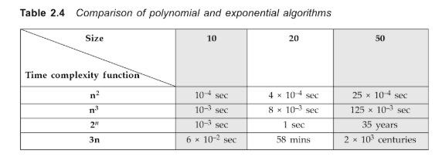
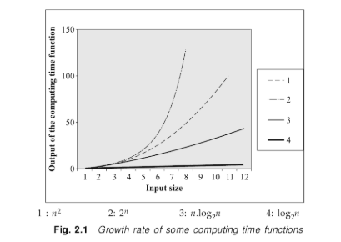

Slide 18
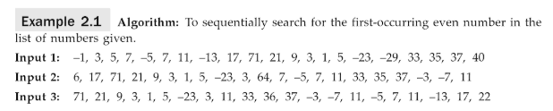
Average, Best and Worst case complexities
The time complexity of an algorithm is dependent on parameters associated with the input / output instances of the problem. Very often the running time of the algorithm is expressed as a function of the input size. in such a case it is fair enough to presume that larger the input size of the problem instances the larger is its running time. But such is not the case always. There are problems whose time complexity is dependent not ‚just on the size of the input but on the nature of the input as well. Example 2.1 illustrates this point.

Slide 19
In the above example Input 2 is best and Input 1 is worst possible case , can happen quickest execution and longest time to complete respectively.
That input instances (or instances) for which the algorithm takes the maximum possible time is called the worst case and the time complexity in such a case is referred to as the worst case time complexity. That input instances for which the algorithm takes the minimum possible time is called the best case and the time complexity in such a case is referred to as the best case time complexity. All other input instances which are neither of the two are categorized as the average cases and the time complexity of the algorithm in such cases is referred to as the average case complexity, input 3 is an example of an average case since it is neither the best case nor the worst case. By and large, analyzing the average case behaviour of algorithms is harder and mathematically involved when compared to their worst case and best case counterparts. Also such an analysis can be misleading if the input instances are not chosen at random or appropriately to cover all possible cases that may arise when the algorithm is put to practice.

Slide 20
Analyzing recursive programs
Recursion is an important concept in computer science. Many algorithms can best be described in terms of recursion.
Recursive procedures
If P is a procedure containing a call statement to itself (Fig. 2.2(a)) or to another procedure that results in a call to itself (Fig. 2.2(b)), then the procedure P is said to be a recursive procedure. In the former case it is termed direct recursion and in the latter case it is termed indirect recursion. Extending the concept to programming can yield program functions or programs themselves that are recursively defined. In such cases they are referred to as recursive functions and recursive programs respectively. Extending the concept to mathematics would yield what arc called recurrence relations. In order that the recursively defined function may not run into an infinite loop it is essential that the following properties are satisfied by any recursive procedure:

Slide 21
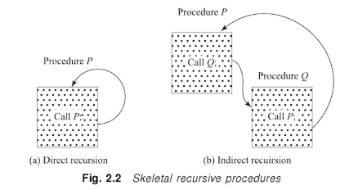
(i) There must be criteria, one or more, called the base criteria or simply base case(s), where the procedure does not call itself either directly or indirectly
(ii) Each time the procedure calls itself directly or indirectly it must be closer to the base
criteria.

Slide 22
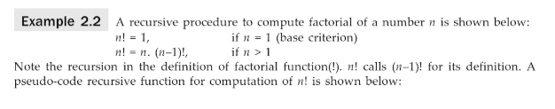
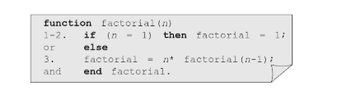

Example 2.2 illustrates a recursive procedure and Example 2.3 a recurrence relation..

